Slide 1

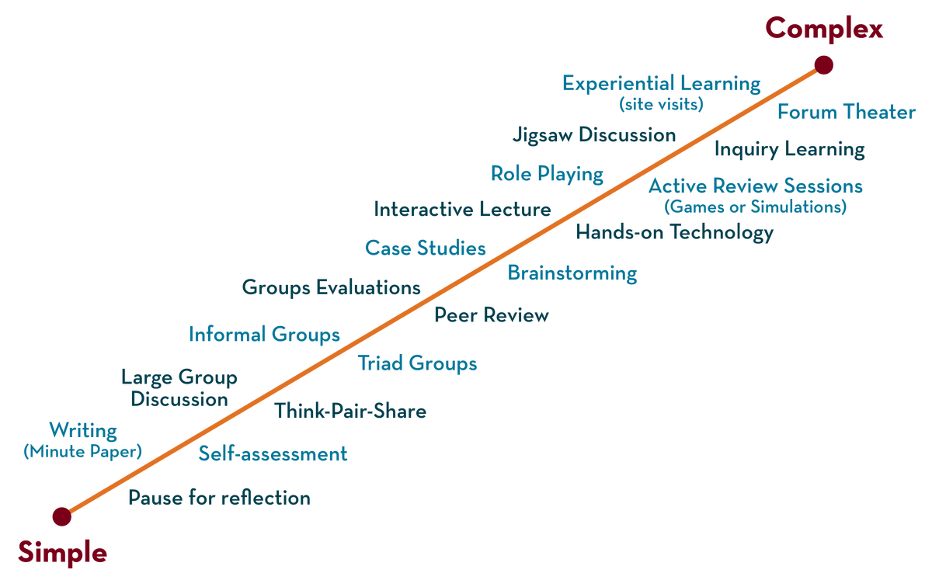
Department of CSE
FRONT END WEB DEVELOPMENT (EPAM)
21CS3017AA/21CS3017PA
Topic:
CSS LAyouts
Session – 6

Slide 2

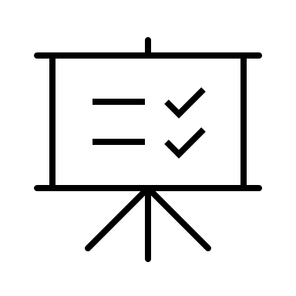

AIM OF THE SESSION
To familiarize students with the basic concept of Layouts in CSS
INSTRUCTIONAL OBJECTIVES
This Session is designed to:
Describing about Layouts for designing the webpages.
LEARNING OUTCOMES
At the end of this session, you should be able to:
Apply the layout for design the webpages.

Slide 3

SESSION INTRODUCTION
CSS LAYOUT
CSS page layout techniques allow us to control the positions of the elements on the page.
3

Slide 4

DESIGN ANALYSIS
SESSION DESCRIPTION
WRAPPER
HEADER
ASIDE
CONTENT
FOOTER

Slide 5
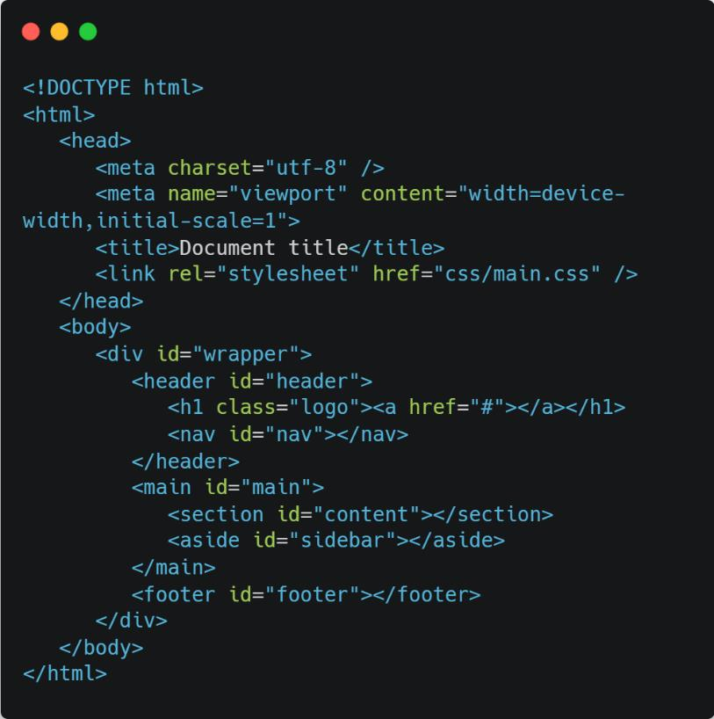
A BASIC TEMPLATE
SESSION DESCRIPTION

Slide 6




SESSION DESCRIPTION (Cont..)
POSITIONING TECHNIQUES
Techniques of building layouts
and positioning content
Float Property
Position Property
Display Property
Z-Index Property
Floats allow elements to appear next to, or apart from, one another
The position property provides different ways to uniquely position an element
The display property specifies the type of box used for an HTML element
To change the order
of how elements are stacked, also known as the z-axis, the z-index property is to be used

Slide 7
SESSION DESCRIPTION (Cont..)
B LO CK - L E V E L VS IN L IN E E L E M E N TS

Slide 8
ELEMENT TYPES
SESSION DESCRIPTION (Cont..)
BLOCK-LEVEL
INLINE

Slide 9
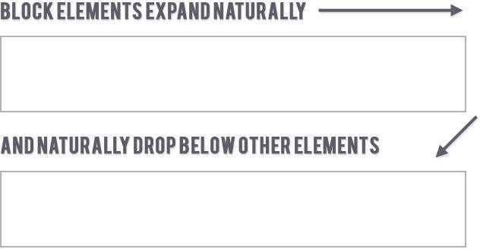
BLOCK-LEVEL ELEMENTS
SESSION DESCRIPTION (Cont..)
If no width is set, will expand naturally to fill its
parent container.
If no height is set, will expand naturally to fit its child elements (assuming they are not floated or positioned).
Can have margins and/or padding. Ignores the vertical-align property.
By default, will be placed below previous elements in the markup (assuming no floats or positioning on surrounding elements).
#navigation a { display: block; padding: 20px 10px;
}
<p>, <div>, <form>, <header>, <nav>, <ul>, <li>, <h1>,…

Slide 10
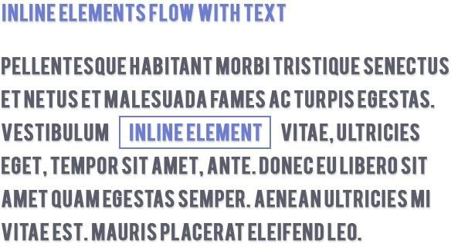
INLINE ELEMENTS
SESSION DESCRIPTION (Cont..)
Flows along with text content.
Will ignore top and bottom margin settings, but will apply left and right margins, and any padding.
If floated left or right, will automatically become a block- level element, subject to all block characteristics.
Is subject to white-space settings in CSS.
li {
Will ignore the width and height properties.
display: inline
}
Is subject to the vertical-align property.
<a>, <span>, <b>, <em>, <i>, <cite>, <mark>, <code>,…

Slide 11
IMPORTANT ELEMENTS
SESSION DESCRIPTION (Cont..)
block-level
inline
<div>
<p>
<ul>
<ol>
<li>
<table>
Document division Paragraph Unordered list Ordered list
List item Table
<a>
<br>
<button>
<em>
<iframe>
<img>
<input>
<label>
<select>
<span>
<textarea>
Anchor Line break Button Emphasis
Inline Frame Image Embed Input (Form Input)
Represents a caption Select
Generic inline container Represents a multi-line plain-text editing control
<form>
<fieldset>
Input form Field set label
<nav>
<header>
<h1> - <h6>
<aside>
<main>
<section>
<footer>
Contains navigation links Section or page header Headings levels 1-6 Aside content
Contains the central content Section of a web page Section or page footer

Slide 12
BLOCK-LEVEL ELEMENTS
SESSION DESCRIPTION (Cont..)
<address>
<article>
<aside>
<blockquote>
<details>
<dialog>
<dd>
<div>
<dl>
<dt>
<fieldset>
<figcaption>
<figure>
<footer>
<form>
<h1>, <h2>, <h3>, <h4>, <h5>, <h6>
<header>
<hgroup>
<hr>
<li>
<main>
<nav>
<ol>
<p>
<pre>
<section>
<table>
<ul>

Slide 13
INLINE ELEMENTS
SESSION DESCRIPTION (Cont..)
<a> | <em> | <progress> | <time>
<abbr> | <embed> | <q> | <u>
<acronym> | <i> | <ruby> | <tt>
<audio> | <iframe> | <s> | <var>
<b> | <img> | <samp> | <video>
<bdi> | <input> | <script> | <wbr>
<bdo> | <ins> | <select>
<br> | <kbd> | <slot>
<button> | <label> | <small>
<canvas> | <map> | <span>
<cite> | <mark> | <strong>
<code> | <meter> | <sub>
<data> | <noscript> | <sup>
<datalist> | <object> | <svg>
<del> | <output> | <template>
<dfn> | <picture> | <textarea>

Slide 14
Do we need to use <h1> - <h6> elements always?
SESSION DESCRIPTION (Cont..)
Production projects here many times target a web application (such as Gmail), not a document-based site (Wikipedia).
In a web application, heading elements can be considered as non-semantic, because a single component rarely contains sections in different levels, hence there is no room for headings in a different level.
Using headings here could lead to issues when trying to relocate that component in DOM.
That being said, there are document parts, even in web apps, such as FAQ, Privacy
Policy, Terms and Conditions. There, we do need to utilize these elements.
Also, use headings and semantic elements in document-based web sites as it helps the SEO and screen-readers.

Slide 15
THE DISPLAY PROPERTY
SESSION DESCRIPTION (Cont..)
The display CSS property sets whether an element is treated as a block or inline element and the layout used for its children, such as flow layout, grid or flex.
span {
display: block;
}
The element generates a block element box, generating line breaks both before and after the element when in the normal flow.
div {
display: inline;
}
The element generates one or more inline element boxes that do not generate line breaks before or after themselves. In normal flow, the next element will be on the same line if there is space.
a {
Generates a block element box that will be flowed with surrounding content as if it were a single inline box.
display: inline-block;
}
section {
display: table;
}
These elements behave like HTML <table> elements. It defines a block- level box. Its children can be styled using properties like
{display: table-cell}, {display: table-row} etc.

Slide 16
SESSION DESCRIPTION (Cont..)
THE DISPLAY PROPERTY
Formally, the display property sets an element's inner and outer display types.
The outer type sets an element's participation in flow layout; the inner type sets the layout of children.
p {
Turns off the display of an element so that it has no effect on layout (the document is rendered as though the element did not exist).
All descendant elements also have their display turned off.
display: none;
}
div {
display: flex;
}
The element behaves like a block element and lays out its content according to the flexbox model.
.container {
display: grid;
}
The element behaves like a block element and lays out its content
according to the grid model.
Flexbox and grid are complex areas and outside of the scope of this document. They do have a separate modules (flexbox, grid) in the CSS standard.
They are not in the state of Recommendation yet, but a Candidate Recommendation and a Candidate Recommendation Draft. Still, these can be considered as stable and supported by modern browsers.

Slide 17
Do we use flexbox in projects?
SESSION DESCRIPTION (Cont..)
Yes, flexbox is a powerful tool, however, many times it leads to more trouble, than it really helps.
We suggest using flexbox only in the below cases:
when it is the simplest solution for the problem
as a last resort

Slide 18
SESSION DESCRIPTION (Cont..)
P O S I T IO N IN G

Slide 19
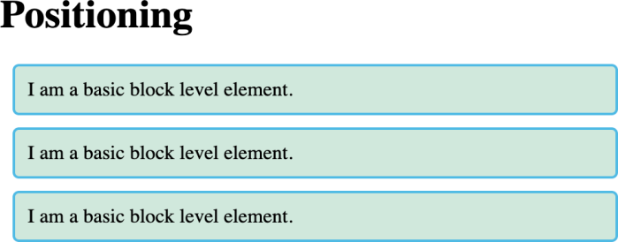
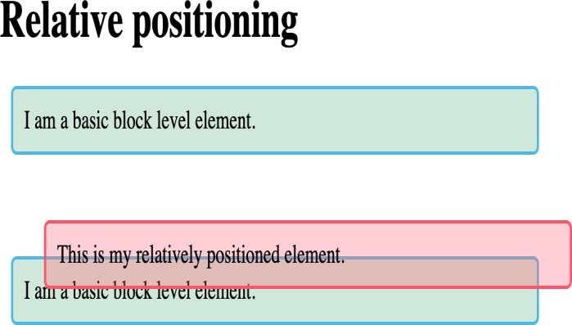
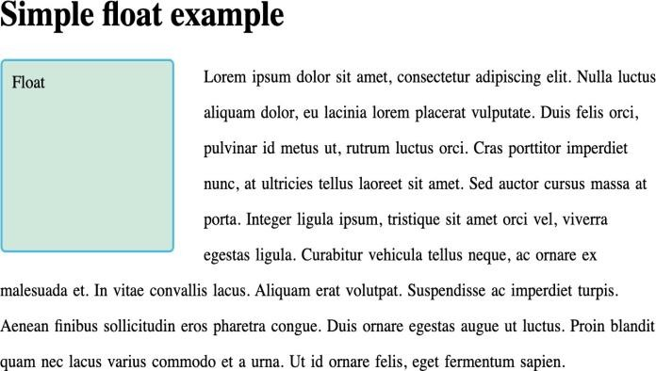
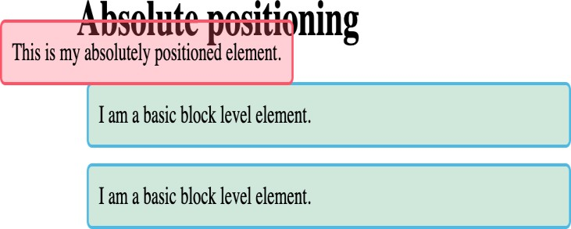
BASIC POSITIONING
SESSION DESCRIPTION (Cont..)

Slide 20
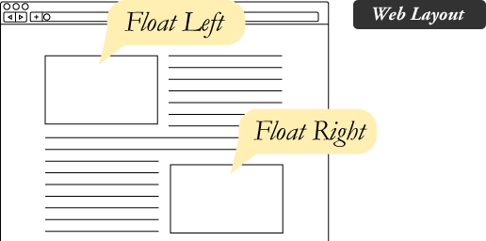
THE FLOAT PROPERTY
SESSION DESCRIPTION (Cont..)
The float CSS property places an element on the left or
right side of its container, allowing text and
inline elements to wrap around it. The element is removed from the normal flow of the page, though
still remaining a part of the flow (in contrast to absolute positioning).
As float implies the use of the block layout, it modifies the computed value of the display values

Slide 21
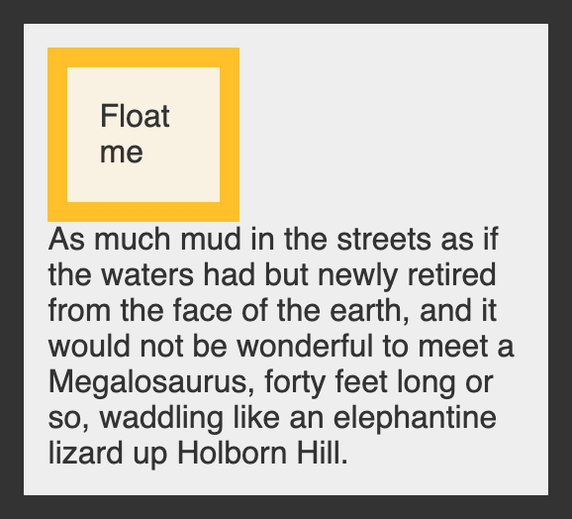
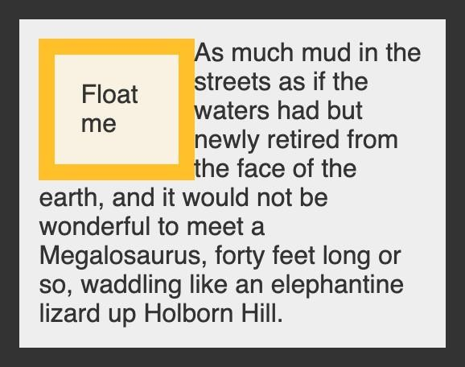
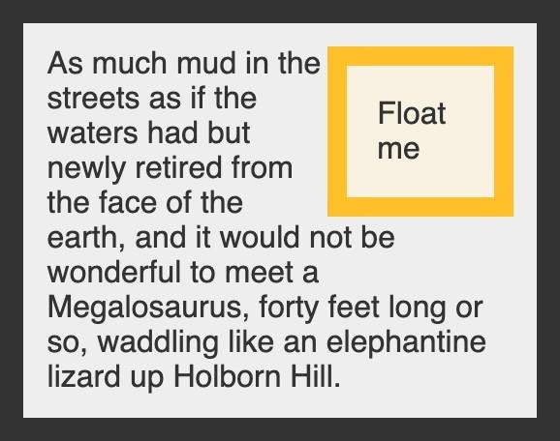
HOW IT LOOKS
SESSION DESCRIPTION (Cont..)
div {
float: none;
}
div {
float: left;
}
div {
float: right;
}

Slide 22
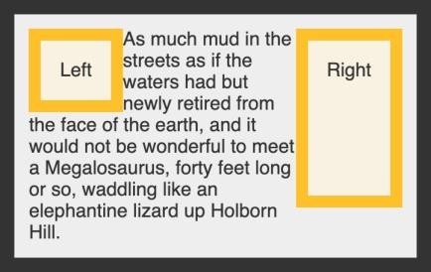
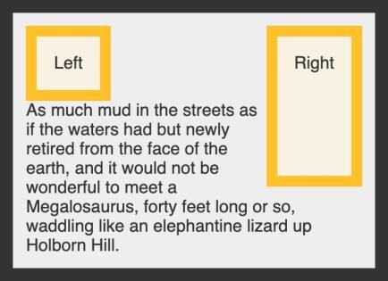
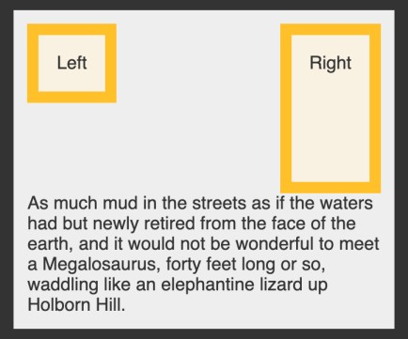
THE CLEAR PROPERTY
SESSION DESCRIPTION (Cont..)
Sometimes you may want to force an item to move below any floated elements. For instance, you may want paragraphs to remain adjacent to floats, but force headings to be on their own line.
div { clear: | none; | div { clear: | left; | div { clear: right;
} |  | } |  | }
 |  |  |  | note: here clear: both provides the same result

Slide 23
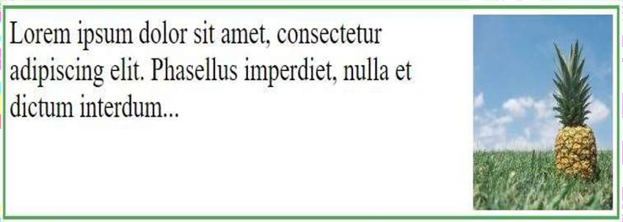
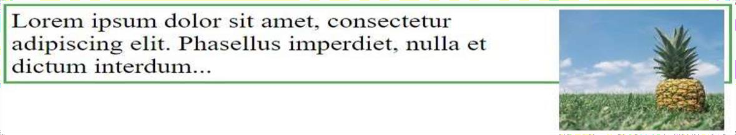
CLEARFIX
SESSION DESCRIPTION (Cont..)
If an element contains only floated elements, its height collapses to nothing. If you want it to always be able to resize, so that it contains floating elements inside it, you need to self-clear its children.
This is called clearfix, and one way to do it is to
add clear to a replaced ::after pseudo-element on it.
with clearfix
#container::after { content: ""; display: block; clear: both;
}
without clearfix

Slide 24
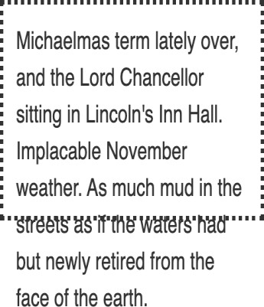
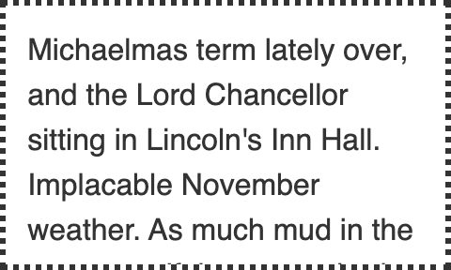
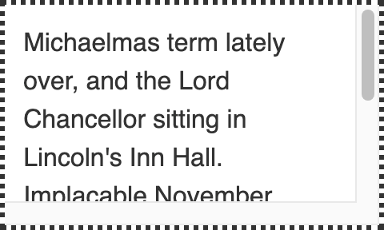
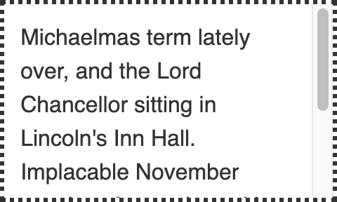
OVERFLOW
SESSION DESCRIPTION (Cont..)
Content is not clipped and may be rendered outside the padding box.
Content is clipped if necessary to fit the padding box.
No scrollbars are provided, and no support for allowing the user to scroll (such as by dragging or using a scroll wheel) is allowed.
Content is clipped if necessary to fit the padding box.
Depends on the user agent.
If content fits inside the
padding box, it looks the same as visible, but still establishes a new block formatting context.
Desktop browsers
provide scrollbars if content
overflows.
Browsers always display scrollbars whether or not any content is actually clipped, preventing scrollbars from appearing or disappearing as content changes.
div { overflow: | visible; | div { overflow: | hidden; | div { overflow: | scroll; | div { overflow: auto;
} |  | } |  | } |  | }

Slide 25








POSITION PROPERTY
SESSION DESCRIPTION (Cont..)
static
The default value
absolute
Positioned relative to the first parent element that has a position other than static.
fixed
Positioned relative to
the browser window
relative
Positioned relative to its
normal position
sticky
Normal + offset relative to its nearest scrolling ancestor

Slide 26

POSITION: STATIC
SESSION DESCRIPTION (Cont..)
The element is positioned according to the normal flow of the document. The top, right, bottom, left, and z-index properties have no effect.
This is the default value.
div {
position: static;
}

Slide 27
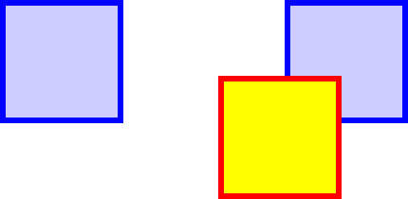
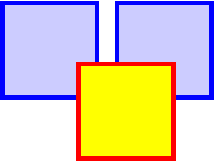
POSITION: RELATIVE AND ABSOLUTE
SESSION DESCRIPTION (Cont..)
The element is positioned according to the normal flow of the document, and then offset relative to itself based on the values of top, right, bottom, and left. The
offset does not affect the position of any other elements; thus, the space given for the element in the page layout is the same as if position were static.
The element is removed from the normal document flow, and no space is created for the element in the page layout. It is positioned relative to its closest positioned ancestor, if any; otherwise, it is placed relative to the initial containing block. Its final position is determined by the values
of top, right, bottom, and left.
div {
position: relative;
top: 40px; left: 40px;
}
div {
position: absolute;
top: 40px; left: 40px;
}

Slide 28
POSITION: FIXED AND STICKY
SESSION DESCRIPTION (Cont..)
div {
position:
div {
position: sticky; bottom: 0;
right: 0;
}
fixed; bottom: 0;
right: 0;
}
The element is positioned according to the normal flow of the document, and then offset relative to its nearest scrolling ancestor and containing block (nearest block-level ancestor) based on the values of top, right, bottom, and left.
An element with position: fixed; is positioned relative to the viewport, which means it always stays in the same place even if the page is scrolled.
The top, right, bottom, and left properties are used to position the element.
The offset does not affect the position of any other elements.
It's treated as relatively positioned until its containing block crosses a specified threshold (such as setting top to value other than auto) within its flow root (or the container it scrolls within), at which point it is treated as "stuck" until meeting the opposite edge of
its containing block.
A fixed element does not leave a gap in the page
where it would normally have been located.

Slide 29
Remember!
SESSION DESCRIPTION (Cont..)
An absolute element is positioned relative to its closest
positioned ancestor
A positioned ancestor could mean any parent, whose position is anything except static. A relatively common mistake is to believe that only position: relative works there.

Slide 30
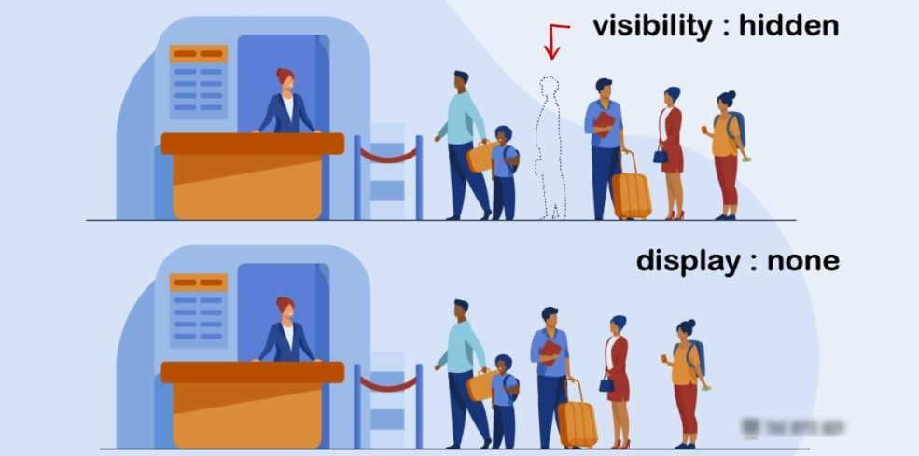
HIDING ELEMENTS - DISPLAY:NONE OR VISIBILITY:HIDDEN
SESSION DESCRIPTION (Cont..)
.passenger {
visibility: hidden;
}
The element will be hidden, but still affects the layout.
.passenger {
display: none;
}
The document is rendered as though the element doesn't exist in the document tree.

Slide 31
SESSION DESCRIPTION (Cont..)
B OX M O D E L

Slide 32
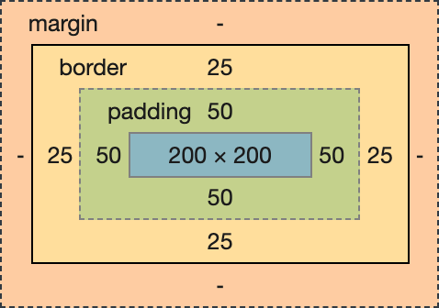
BOX MODEL
SESSION DESCRIPTION (Cont..)
Content - The content of the box, where text and images appear
Padding - Clears an area around the content. The padding is transparent
Border - A border that goes around the padding and content
Margin - Clears an area outside the border. The margin is transparent

Slide 33
MARGIN AND PADDING: TOP, RIGHT, BOTTOM, LEFT
SESSION DESCRIPTION (Cont..)
margin-top: <length> | <percentage> | auto margin-right: <length> | <percentage> | auto margin-bottom: <length> | <percentage> | auto margin-left: <length> | <percentage> | auto
padding-top: <length> | <percentage> padding-right: <length> | <percentage> padding-bottom: <length> | <percentage> padding-left: <length> | <percentage>
margins: a positive value places it farther from its neighbors, while a negative value places it closer.

Slide 34
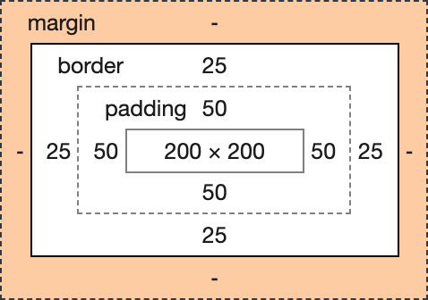
MARGIN AND PADDING: SHORTHAND
SESSION DESCRIPTION (Cont..)
margin: [ <length> | <percentage> | auto inherit margin: all
margin: vertical horizontal margin: top horizontal bottom margin: top right bottom left
]{1,4}
padding: [ <length> | <percentage>
]{1,4} padding : all
padding : vertical horizontal
vertical is first!
padding : top right bottom left padding : top horizontal bottom
Always starts with top.
Even when only 3 values are provided. In this case left = right.

Slide 35

MARGIN AND PADDING: SHORTHAND
SESSION DESCRIPTION (Cont..)
Remember: vertical is first, starts with top, and goes clockwise!
padding : vertical horizontal padding : top right bottom left
vertical is first!
starts with top.

Slide 36
SESSION DESCRIPTION (Cont..)
B OX - S I Z IN G

Slide 37


BOX-SIZING: DIFFERENT MODELS
SESSION DESCRIPTION (Cont..)
Same HTML, same
CSS except the box-sizing
div {
box-sizing: content-box;
}
div {
box-sizing: border-box;
}
The default
The traditional (IE)

Slide 38
BOX-SIZING: COMPARISON
SESSION DESCRIPTION (Cont..)
span {
display: block; background: springgreen; height: 100%;
}
div {
box-sizing: content-box; background: silver; width: 200px;
height: 200px; padding: 50px;
border: 25px solid royalblue;
}
<div>
<span>
</span>
</div>
div {
box-sizing: content-box;
}
div {
box-sizing: border-box;
}
The width and height properties includes only the content. Border and padding are not included.
The width and height properties includes content, padding and border.

Slide 39
BOX-SIZING: CONTENT-BOX
SESSION DESCRIPTION (Cont..)
div {
box-sizing: content-box; background: silver; width: 200px;
height: 200px; padding: 50px;
border: 25px solid royalblue;
}
This is the initial and default value as specified by the CSS standard. The width and height properties include the content,
but does not include the padding, border, or margin.
Here, the dimensions of the element are calculated as:
200px
+ 2 * 50px.
+ 2 * 25px
= 350px
// width
// padding
// border
// total width
width = width of the content
height = height of the content.
Borders and padding are not included in the calculation.

Slide 40
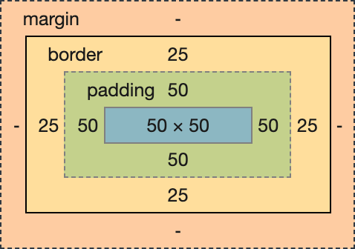
BOX-SIZING: BORDER-BOX
SESSION DESCRIPTION (Cont..)
div {
box-sizing: border-box; background: silver; width: 200px;
height: 200px; padding: 50px;
border: 25px solid royalblue;
}
200px
= 200px
// width
// total width
The width and height properties include the content, padding, and border, but do not include the margin. Note that padding and border will be inside of the box.
The content box can't be negative and is floored to 0, making it impossible to use
border-box to make the element disappear.
Here the dimensions of the element are calculated as:
width = border + padding + width of the content
height = border + padding + height of the content.

Slide 41
BOX-SIZING: WHAT TO USE IN GENERAL?
SESSION DESCRIPTION (Cont..)
It is often useful to set box-sizing to border-box to layout elements.
This makes dealing with the sizes of elements much easier, and generally eliminates a number of pitfalls you can stumble on while laying out your content.
On the other hand, when using position: relative or position: absolute, use of box- sizing: content-box allows the positioning values to be relative to the content, and independent of changes to border and padding sizes, which is sometimes desirable.

Slide 42
SESSION DESCRIPTION (Cont..)
M A RG IN CO L L A P S IN G

Slide 43
MARGIN COLLAPSING
SESSION DESCRIPTION (Cont..)
The top and bottom margins of blocks are sometimes combined (collapsed) into a single
margin whose size is the largest of the individual margins (or just one of them, if they are equal), a behavior known as margin collapsing.
Note that the margins of floating and absolutely positioned elements never collapse.
Margin collapsing occurs in three basic cases:
Adjacent siblings
No content separating parent and descendants
Empty blocks

Slide 44

MARGIN COLLAPSING, CASE 1: ADJACENT SIBLINGS
SESSION DESCRIPTION (Cont..)
<div id="block">
</div>
<div id="adjacent">
</div>
#block {
background: silver; margin-bottom: 10px;
}
Adjacent siblings almost always collapse
You can get a rid of issues about margin collapsing by defining only top or bottom margins.
#adjacent {
background: springgreen; margin-bottom: 10px;
}
No margins to collapse, no cry ¯\_(ツ)_/¯
div {
width: 100px; height: 100px;
}

Slide 45
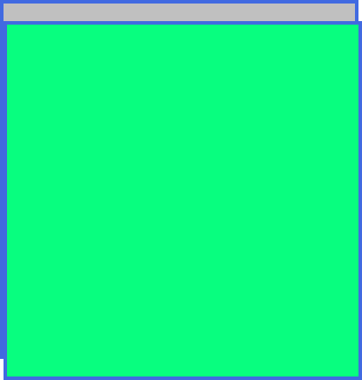
MARGIN COLLAPSING: NO CONTENT SEPARATING PARENT AND
DESCENDANTS
SESSION DESCRIPTION (Cont..)
<div id="parent">
<div id="child">
</div>
</div>
#parent {
background: silver;
}
#child {
background: springgreen;
}
div {
width: 200px; height: 200px; margin-top: 10px;
border: 2px solid royalblue;
}
we have a border = no collapsing

Slide 46

MARGIN COLLAPSING: NO CONTENT SEPARATING PARENT AND
DESCENDANTS
SESSION DESCRIPTION (Cont..)
<div id="parent">
<div id="child">
</div>
</div>
#parent {
background: silver;
}
#child {
background: springgreen;
}
div {
width: 200px; height: 200px; margin-top: 10px;
}
Nothing separates the parent and the descendant = margins collapsing

Slide 47
MARGIN COLLAPSING, CASE 2: NO CONTENT SEPARATING PARENT AND
DESCENDANTS
SESSION DESCRIPTION (Cont..)
Rules are pretty complex, yet basically if something (border, padding, etc.) separates the blocks = no collapsing
If there is no border, padding, inline part, block formatting context created, or clearance to separate the margin-top of a block from the margin-top of one or more of its descendant blocks; or no border, padding, inline content, height, min-height, or max-height to separate the margin-bottom of a block from the margin-bottom of one or more of its descendant blocks, then those margins collapse. The collapsed margin ends up outside the parent.

Slide 48

MARGIN COLLAPSING, CASE 3: EMPTY BLOCKS
SESSION DESCRIPTION (Cont..)
<div id="first"></div>
<div id="middle"></div>
<div id="last"></div>
#first, #last { width: 100px; height: 100px;
background: springgreen;
}
#middle { width: 100px;
the #middle div does have height = no collapsing
height: 10px;
margin-top: 10px; margin-bottom: 10px; background: royalblue;
}

Slide 49

MARGIN COLLAPSING: EMPTY BLOCKS
SESSION DESCRIPTION (Cont..)
<div id="first"></div>
<div id="middle"></div>
<div id="last"></div>
#first, #last { width: 100px; height: 100px;
background: springgreen;
}
#middle {
width: 100px;
margin-top: 10px; margin-bottom: 10px; background: royalblue;
}
empty #middle div, no height = margins collapsing

Slide 50
SESSION DESCRIPTION (Cont..)
F IG H T IN G W I T H W H I T ES PACES

Slide 51

Inherent Whitespaces
SESSION DESCRIPTION (Cont..)
<span></span>
<span></span>
<span></span>
span {
display: inline-block; background: royalblue; width: 100px;
height: 100px;
}

Slide 52

REMOVE WHITESPACES BETWEEN ELEMENTS
SESSION DESCRIPTION (Cont..)
<nav>
<a href="#"> One</a><a href="#"> Two</a><a href="#"> Three</a>
</nav>
Never ever do this!
<nav>
<a href="#">One</a>
<a href="#">Two</a>
<a href="#">Three</a>
</nav>
Usually, we don’t have a control on how DOM is assembled, also, relying on this makes the code extremely brittle.
<nav>
<a href="#">One</a><!--
--><a href="#">Two</a><!--
--><a href="#">Three</a>
</nav>
Any changes in content could lead to bugs in design.
<nav>
<a href="#">One
<a href="#">Two
<a href="#">Three
</nav>

Slide 53

REMOVE VISIBLE WHITESPACES WITH CSS
SESSION DESCRIPTION (Cont..)
<div>
<span></span>
<span></span>
<span></span>
</div>
div {
font-size: 0;
}
span {
display: inline-block; background: royalblue; width: 100px;
height: 100px;
}

Slide 54
SESSION DESCRIPTION (Cont..)
Z - IN D E X A N D T H E STACK IN G O R D E R

Slide 55
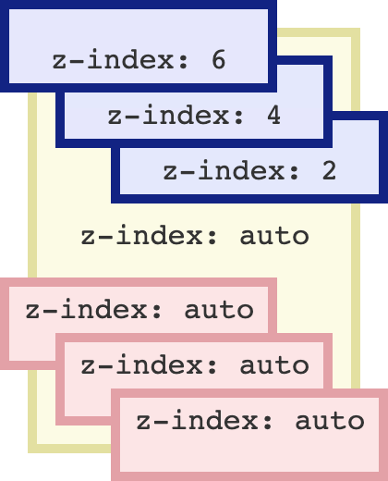
Z-INDEX
SESSION DESCRIPTION (Cont..)
The z-index CSS property sets the z-order of a positioned element and its descendants or flex items. Overlapping elements with a larger z-index cover those with a smaller one.
/* Keyword value
*/ z-index: auto;
/* <integer> values
*/ z-index: 0;
z-index: 3;
z-index: 289;
z-index: -1; /* Negative values to lower the
priority */
/* Global values
*/ z-index: inherit;
z-index: initial; z- index: unset;

Slide 56
STACKING CONTEXT
SESSION DESCRIPTION (Cont..)
The stacking context is a three-dimensional conceptualization of HTML elements along an imaginary z-axis relative to the user, who is assumed to be facing the viewport or the webpage. HTML elements occupy this space in priority order based on element attributes.
In summary:
Stacking contexts can be contained in other stacking contexts, and together create a hierarchy of stacking contexts.
Each stacking context is completely independent of its siblings: only descendant elements are considered when stacking is processed.
Each stacking context is self-contained: after the element's contents are stacked, the whole element is considered in the stacking order of the parent stacking context.
A stacking context is formed, anywhere in the document, by any element in the following scenarios:
Root element of the document (<html>).
Element with a position value absolute or relative and z-index value other than auto.
Element with a position value fixed or sticky.

Slide 57
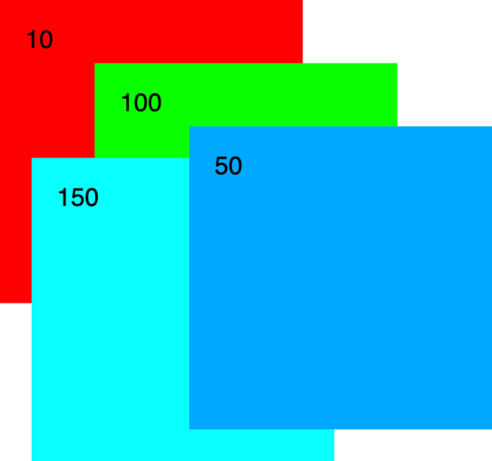
STACKING CONTEXT
SESSION DESCRIPTION (Cont..)
.one {
background: #f00; top: 100px; left: 200px;
z-index: 10;
}
<div class="one">10
<div class="two">100</div>
<div class="three">150</div>
</div>
Different stacking contexts
<div class="four">50</div>
.two {
background: #0f0; top: 50px;
left: 75px;
z-index: 100;
}
.three { background: #0ff; top: 125px; left: 25px;
z-index: 150;
}
the .four div is on the top, despite having z-index: 50!
.four {
background: #0af; top: 200px;
left: 350px; z-index: 50;
}
div {
width: 200px; height: 200px;
padding: 20px; position: absolute;
}

Slide 58
SELF-ASSESSMENT QUESTIONS
…
…
…
…
…
….
…
…
…
…

Slide 59
TERMINAL QUESTIONS
1. Describe
2. List out
3. Analyze
4. Summarize

Slide 60
REFERENCES FOR FURTHER LEARNING OF THE SESSION
Sites and Web links:
CSS Layout cookbook - https://developer.mozilla.org/ru/docs/Web/CSS/Layout_cookbook
Flexbox froggy - https://flexboxfroggy.com/
Learn CSS Grid - https://learncssgrid.com/

Slide 61
THANK YOU
Team – Course Name

